Slide 1
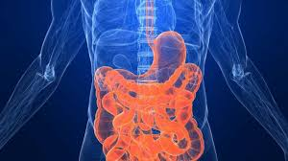
11ATAR Biology
Week 30
Acquiring nutrients in animals
(Digestive System)

Slide 2

Year 11 Biology Work Schedule
It is important to remain on schedule during this Semester.
Moodle
Have you visited Moodle this week? Yes / No
Tasks
Are you on schedule? Yes / No
When is your next task due?

Slide 3
Learning Intentions
Understand the structure and function of animal digestive systems.
Success Criteria
Students will be able to:
Describe the structure and function of organs within the digestive system.
Differentiate between a gastrovascular cavity and specialised alimentary canal.
Explain mechanical and chemical digestion.
Identify specialisations within the digestive system related to diet (herbivores vs carnivores).

Slide 4
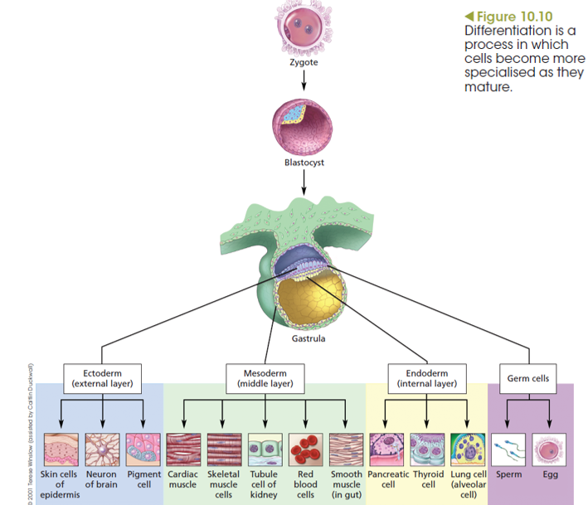
Multicellularity
The evolution from unicellular organisms to multicellular organisms required three organizing principles:
  Cell division so that many cells are created.
  Specialisation (one function) of cells.
  Communication with other cells.
Notes:
Unicellular organisms such as protozoans are complete functioning organisms. All the needs of the organism (e.g. nutrients, energy and water) and functions (e.g. intake of nutrients and energy, processing of nutrients to release energy, and expulsion of waste products) take place within the boundary of the cell.
The microscopic size of the cell allows these processes to occur efficiently.
A single cell has a high surface area to volume ratio. This means that the size of the plasma membrane (its surface area) is sufficient to service the total volume of the cytoplasm. Oxygen, nutrients and carbon dioxide can diffuse directly across the plasma membrane in amounts sufficient to meet the needs of the entire cell.

Slide 5
Multicellular – Cell Specialisation
All specialised cells originate from stem cells.
Stem cells differ from other cells in the body in three important ways:
  They are unspecialised (have not yet specialised into a particular type of cell).
  They have the potential to divide and replicate for long periods of time.
  These relatively unspecialised cells can differentiate to form different specialised cells.

Slide 6
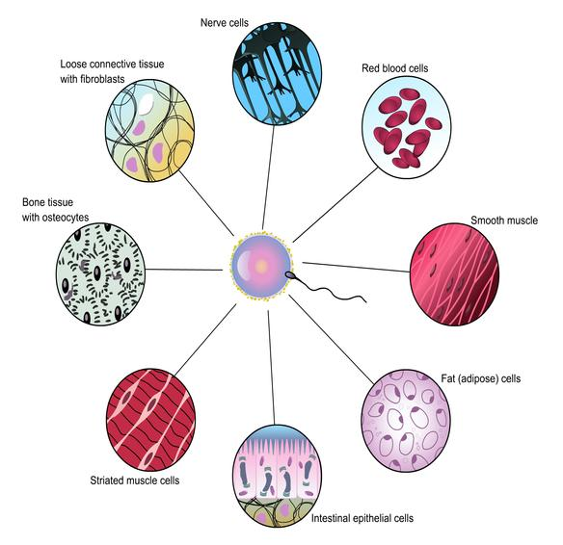
Multicellular – Cell Specialisation
During early development of the embryo, cell layers migrate to different regions, genes are switched on or off in response to neighbouring cells and environmental cues.
Cell appearance and function is determined by active genes (which genes are switched on).
Specialised cells are created.
In humans this results in 230 different types of cells.
The cells together form tissues and tissues together form organs, which make up all the different part of the multicellular organism.

Slide 7
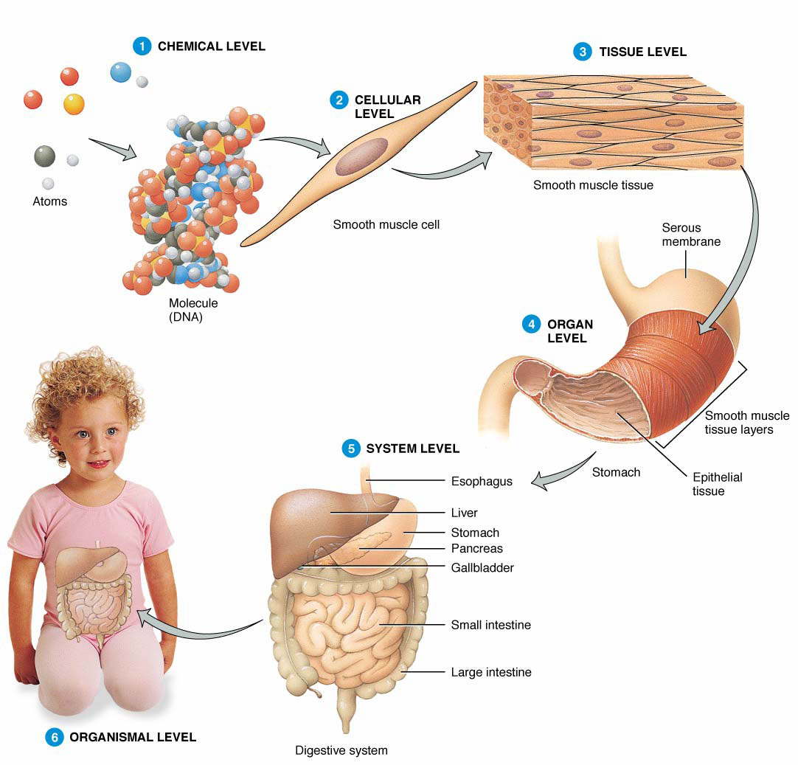
Levels of Organisation
Organization is a defining feature of living things.
Organisms are organized according to a hierarchy of structural levels.

Slide 8
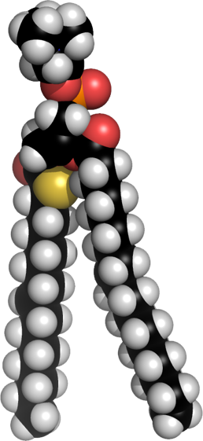
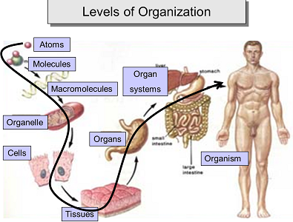
Levels of Organisation
Levels of Organisation -
  Chemical and molecular level:
  Atoms, molecules and macromolecules form the most basic level of organization. This level includes all the chemicals essential for maintaining life.
Phospholipid

Slide 9
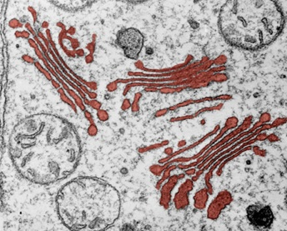
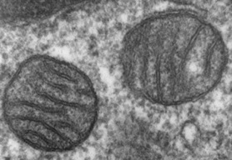
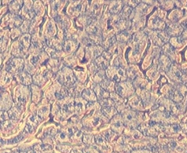
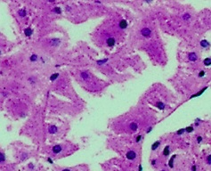
Levels of Organisation
  Organelle level:
  Molecules associate together to form complex, highly specialized structures and organelles within cells. e.g. mitochondria, Golgi apparatus.
  Cellular level:
  Cells are the basic structural and functional units of organisms. Cells become specialized to perform specific functions as a result of differentiation during development.
Golgi apparatus
Mitochondria
Liver cells
Kidney tubule cells

Slide 10
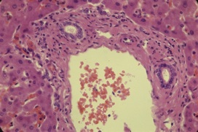
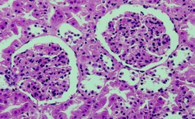
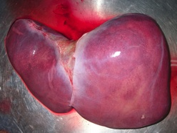
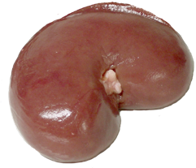
Levels of Organisation
  Tissue level:
  Tissues are composed of groups of cells of similar structure that perform particular related functions. Examples include: epithelial tissue, liver tissue, bone, and kidney tissue.
  Organ level:
  Organs are structures of definite form and structure, comprising two or more tissues. Examples include: kidneys, liver, heart, brain, lungs, stomach.
Liver tissue and bile duct
Kidney tissue: glomeruli, tubule cells, Bowman’s capsule
Photo:Suseno
Liver
Kidney

Slide 11
Levels of Organisation
  System level:
  In humans and other animals, organs form parts of larger units known as organ systems. An organ system is an association of organs with a common function, e.g. digestion or excretion.
Can you name the 11 organ systems of the human body?

Slide 12
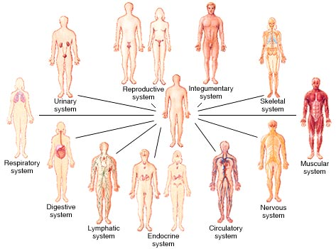
Levels of Organisation
  System level:
  In humans and other animals, organs form parts of larger units known as organ systems. An organ system is an association of organs with a common function, e.g. digestion or excretion.
11 organ systems make up the body.
Notes:
The skin and accessory structures perform a variety of essential functions, such as protecting the body from invasion by microorganisms, chemicals, and other environmental factors; preventing dehydration; acting as a sensory organ; modulating body temperature and electrolyte balance; and synthesizing vitamin D

Slide 13
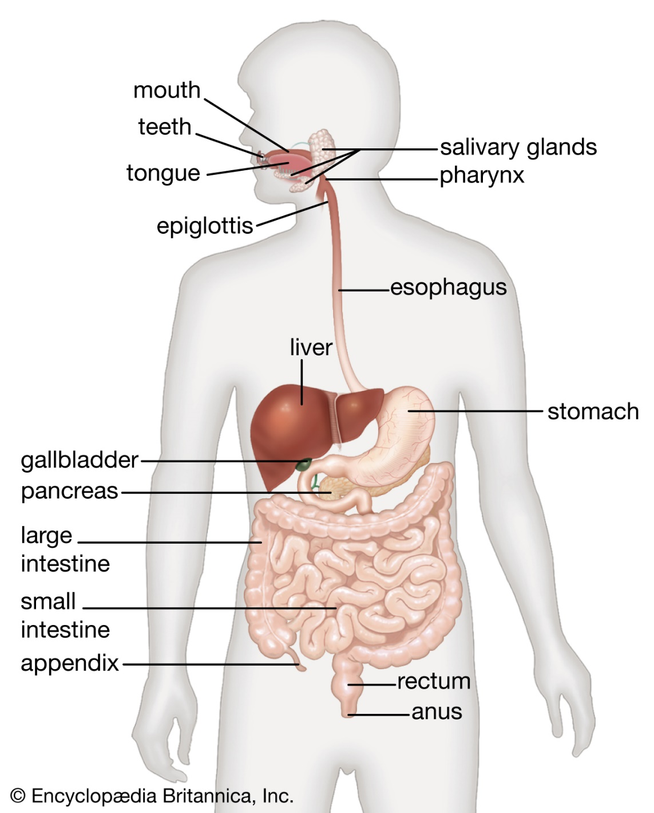
Previous Knowledge Check In
v

Slide 14
Previous Knowledge Check In

Slide 15
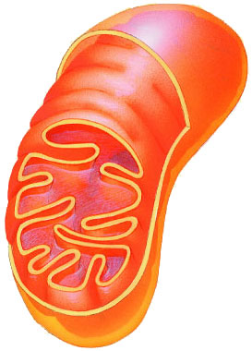
What do Animals need to Live?
Animals make energy using:
  food
  oxygen
Animals build bodies using:
  food for raw materials (manufacture amino acids, sugars, fats, nucleotides)
  ATP energy for synthesis
food
ATP
O₂
mitochondria

Slide 16
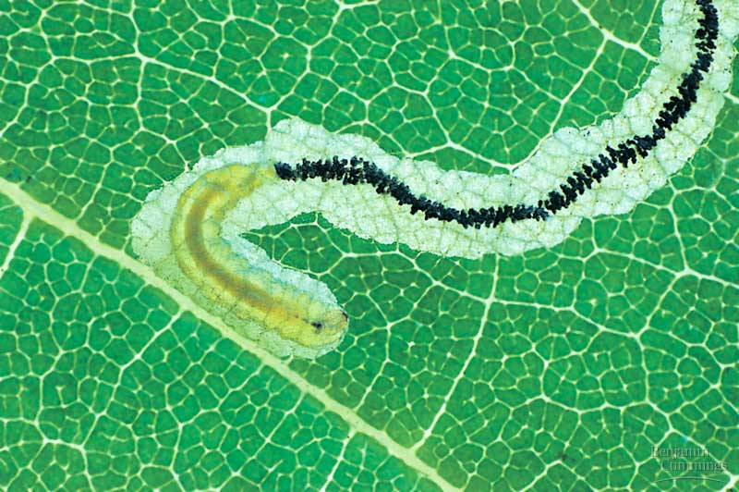
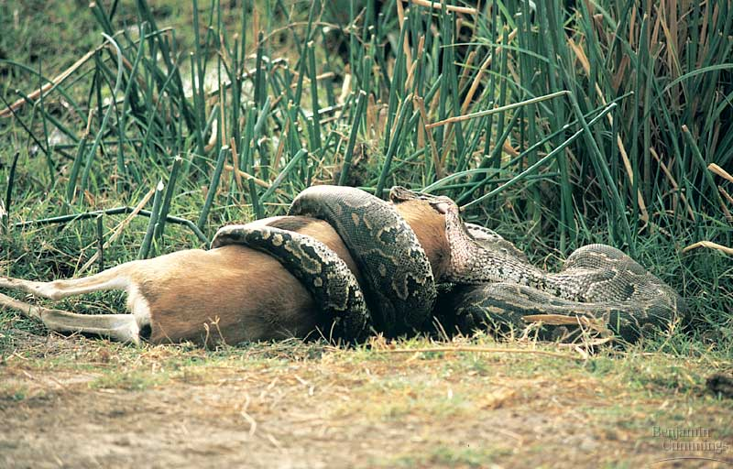
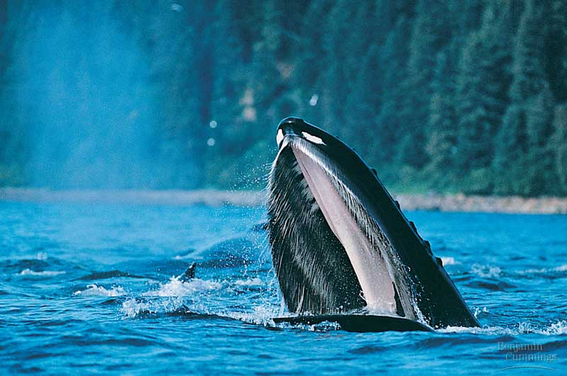
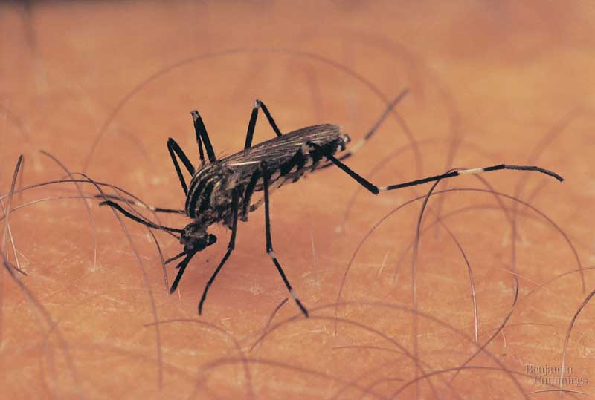
How do Animals get their Food?
Animals can get their food in a variety of ways.
  Filter feeding
  Living inside their food
  Fluid feeding
  Bulk feeding
Notes:
Filter feeding is a method of aquatic feeding in which the animal takes in many small pieces of prey at one time. As opposed to predators who seek out specialized food items, filter feeding is simply opening up your mouth and taking in whatever happens to be there, while filtering out the undesirable parts.
Fluid feeding is defined as getting your nutrients by consuming the fluids of another organism. Animals which practice fluid feeding include hummingbirds, spiders, aphids, vampire bat, ticks, mosquitos, and leeches. Except for hummingbirds, that's veritably a rogue's gallery of reviled organisms

Slide 17
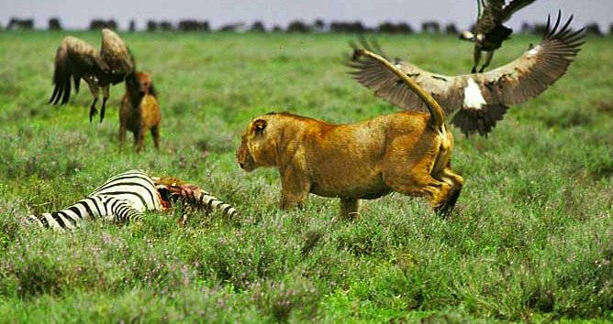
Different Types of Diets
All animals eat other organisms
  Herbivores (eg. gorillas, cows, rabbits, snails) eat mainly plants.
  Carnivores (eg. sharks, hawks, spiders, snakes) eat other animals.
  Omnivores (eg. cockroaches, bears, raccoons, humans) eat animals and plants

Slide 18
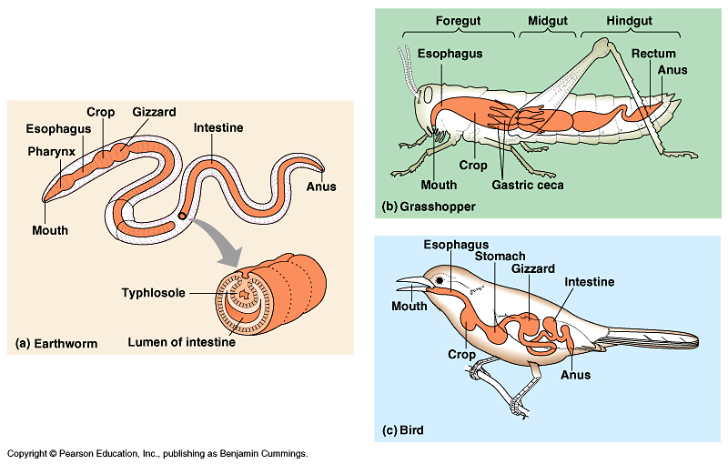
Digestive Systems
Remember animals get oxygen from gas exchange but for life, animals still need to get food.
Animals acquire the food (nutrients) through the digestive system.

Slide 19
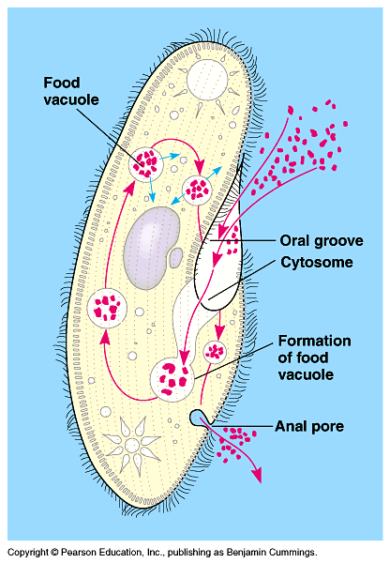
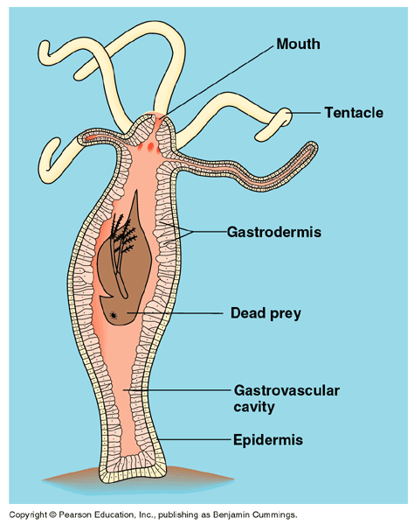
Getting & Using Food
Ingest
  taking in food.
Digest
  mechanical digestion - breaking up food into smaller pieces.
  chemical digestion - breaking down food into molecules small enough to be absorbed into cells. This involves chemical reactions and requires enzymes.
Absorb
  absorb nutrients across cell membranes by diffusion and active transport
Elimination or Egestion
  undigested material passes out of body
intracellular
digestion
extracellular
digestion

Slide 20
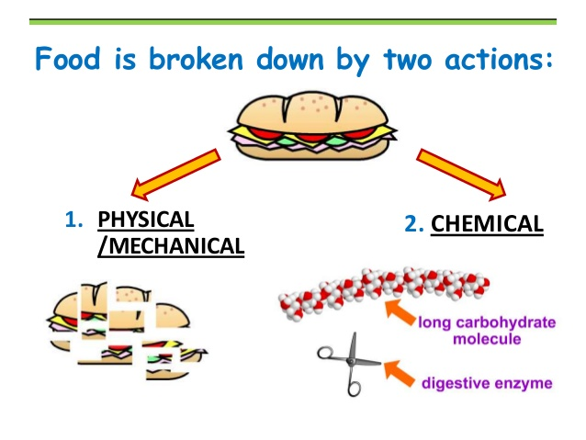
Digestion
Important to understand the difference between mechanical and chemical digestion
  mechanical digestion - breaking up food into smaller pieces. Eg. Chewing the food.
  chemical digestion - breaking down food into molecules small enough to be absorbed into cells. This involves chemical reactions and requires enzymes.

Slide 21
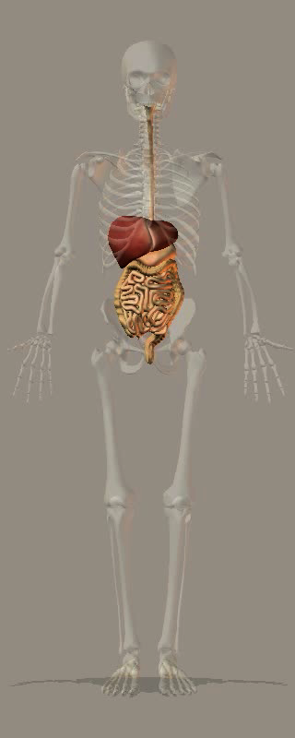
Human Digestive System
The role of the digestive system to ingest food, digest it, absorb nutrients from the food, and eliminate undigested material.
The organs of the digestive system can be divided into two groups:
  Those that make up the alimentary canal itself: mouth pharynx, oesophagus, stomach, small intestine, large intestine rectum, and anus.
  Accessory organs: tongue, salivary glands, pancreas, liver, and gall bladder.
The GI tract performs all digestive functions.
The accessory organs assist in digestion, e.g. through secretion of enzyme-rich fluids.

Slide 22
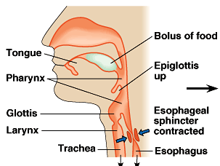
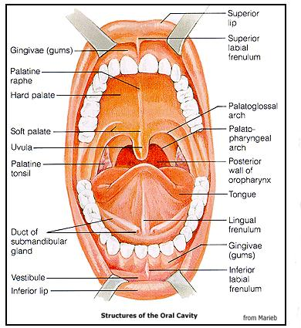
Human Digestive System
Digestion starts in the mouth
Functions of the mouth
  Mechanical digestion - Teeth break up food up into smaller pieces and mix it with saliva.
  Chemical digestion – The enzyme salivary amylase enzyme breakdowns starch.
  Produce mucus to protect soft lining of digestive system and lubricates food for easier swallowing.
  Anti-bacterial chemicals to kill bacteria that enter mouth with food.

Slide 23
Lesson 2

Slide 24
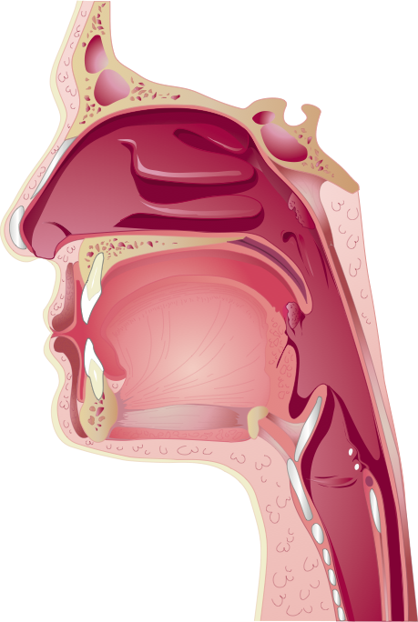
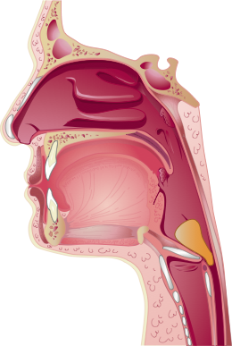
Human Digestive
System
Breathing is possible through the nose and mouth when the epiglottis is raised.
Swallowing sends food (now called a bolus) down into the oesophagus.
The features of the mouth and pharynx allow swallowing or breathing, but not at the same time.
As swallowing begins, the epiglottis is lowered so that food is directed down the oesophagus.
The tongue and muscles at the back of the throat contract to force food into the oesophagus.
When swallowing, the epiglottis is lowered, directing food into the esophagus. Breathing is not possible during this time.

Slide 25
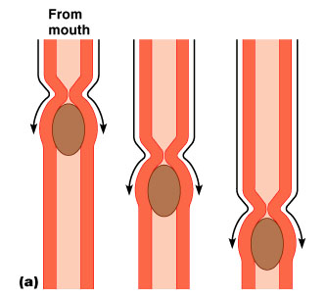
Human Digestive System
Peristalsis (involuntary muscle contractions to move food along) squeeze the food down the esophagus into the stomach.
The action of peristalsis actually moves food along the whole length of the gastrointestinal tract.
Video showing peristalsis https://www.youtube.com/watch?v=rJS-Kh5wCQU
Notes:
https://www.youtube.com/watch?v=rJS-Kh5wCQU

Slide 26
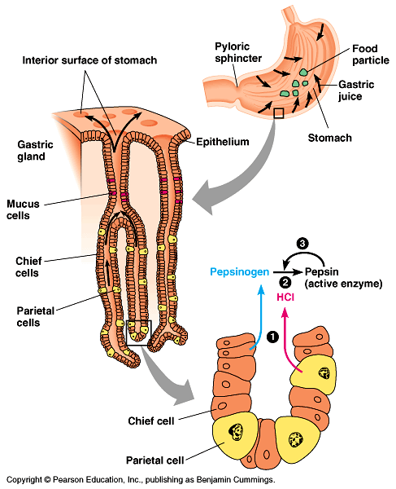
Human Digestive System
The oesophagus delivers the bolus to the stomach.
Functions of the stomach
  Disinfect food as it contains hydrochloric (HCl) acid at pH 2 which kills bacteria.
  Food storage (can stretch to fit about 2L food).
  Chemical digestion of protein using the pepsin enzyme. Pepsin is secreted in an inactive form, called pepsinogen by specialized chief cells in gastric pits. Parietal cells, also in the pits, secrete HCl acid which converts pepsinogen to the active pepsin only when both reach the opening of the pits. This along with a mucous lining helps to stop the pepsin and HCl acid destroying the stomach itself.

Slide 27
Human Digestive System
About every 20 seconds, the stomach contents are mixed by the churning action of smooth muscles. As a result of mixing and enzyme action, what begins in the stomach as a recently swallowed meal becomes a nutrient-rich broth known as chyme.
At the opening from the stomach to the small intestine is the pyloric sphincter, which helps regulate the passage of chyme into the intestine.
The chyme enters the first part of the small intestine, known as the duodenum.
The duodenum is where secretions from the liver and the pancreas are added to the chyme.

Slide 28
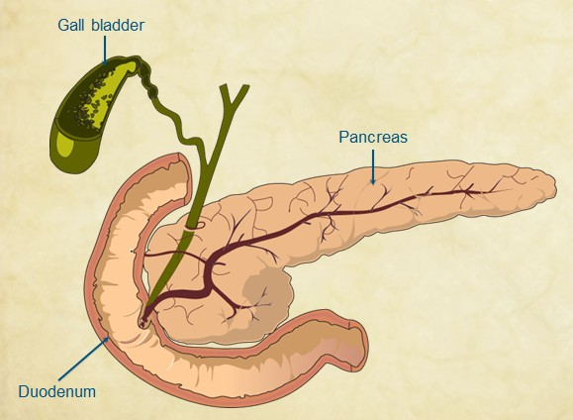
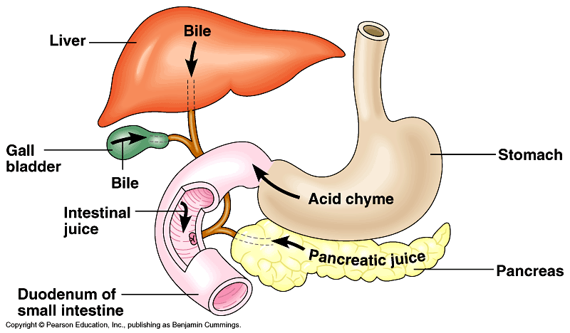
Human Digestive System
The pancreas adds pancreatic juice, while the liver adds bile to the duodenum.
Functions of pancreatic juice -
  Chemical digestion of carbohydrate using pancreatic amylase.
  Chemical digestion of proteins using trypsin.
  Chemical digestion of fats using pancreatic lipase.
  Neutralise stomach acids by secreting bicarbonate.
Functions of bile from the liver (bile is produced by the liver by stored in the gall bladder)-
  Mechanical digestion of fats. Bile emulsifies fat (breaks into smaller droplets) to increase surface area for chemical digestion.

Slide 29
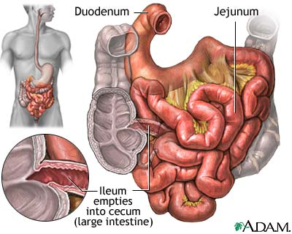
Human Digestive System
Food continues to move through the small intestine from the first section (duodenum) to the second section (jejunum). This movement is still via peristalsis.
In the jejunum the final enzymes for chemical digestion are secreted. They are –
  Maltase, sucrase and lactase to digest sugars into the simplest form.
  Peptidase to digest proteins.

Slide 30
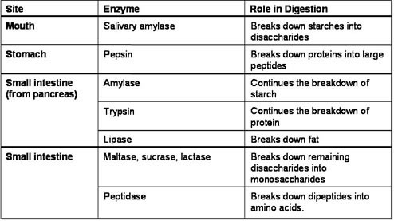
Human Digestive System
Summary of Chemical Digestion

Slide 31
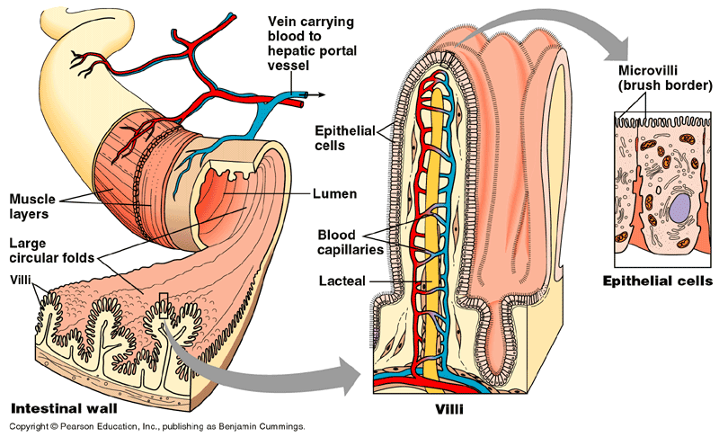
Human Digestion System
Once food is broken down into its simplest nutrients via digestion is must be absorbed into the blood stream.
Absorption is the process where nutrients move into the blood or lymph by diffusion or active transport.
Absorption can happen along the whole length of the gastrointestinal tract. Alcohol and drugs are absorbed in the stomach. However, most nutrients are absorbed by the small intestine.
Absorption occurs in the small intestine through villi and microvilli. These are finger-like projections of the lining which increases surface area for absorption.

Slide 32
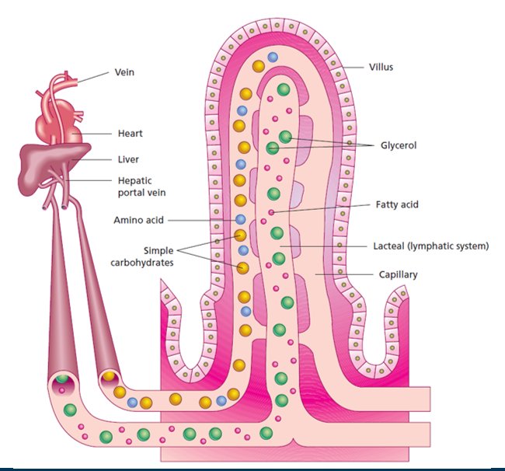
Human Digestion System
The intestinal villi project into the gut lumen (opening) and provide an immense surface area for nutrient absorption.
The villi are lined with epithelial cells and each has a brush border of many microvilli which further increase the surface area.
Inside each villi is a lymph vessel, called a lacteal and blood capillaries.
Nutrients are transported into either the lymph or blood to then be delivered to the rest of the body.
Notes:
Fats = lacteal
Protein and glucose blood

Slide 33
Human Digestive System
Finally peristalsis pushes the chyme into the large intestine.
Function of large intestine -
  Absorb water
  Bacteria found in the large intestine produce vitamins A and K which is then absorbed
  Compact undigested food
  Elimination of the leftover materials (faeces) through the rectum and anus.

Slide 34
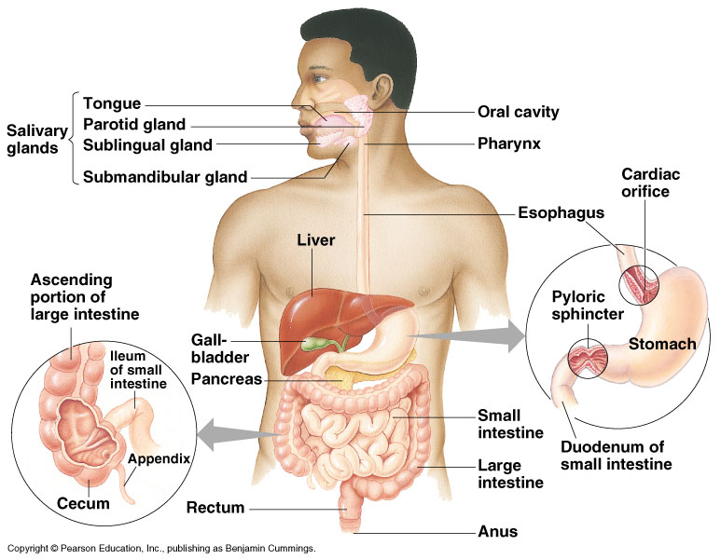
Human Digestive System
After chewing and swallowing, it takes 5 to 10 seconds for food to pass down the esophagus to the stomach, where it spends 2 to 6 hours being partially digested.
Final digestion and nutrient absorption occur in the small intestine over a period of 5 to 6 hours.
In 12 to 24 hours, any undigested material passes through the large intestine, and faeces are expelled through the anus.

Slide 35
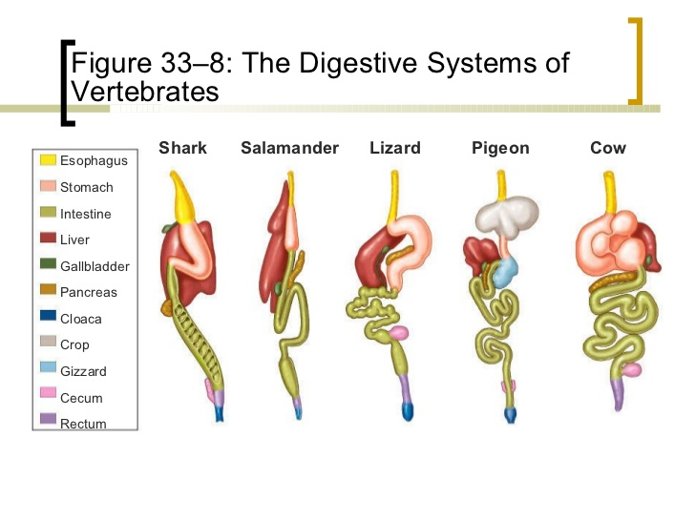
Different Digestive Systems
Different diets means different structures are needed in the digestive system.
Main differences occur in the -
  teeth
  length of digestive system
  number and size of digestive organs

Slide 36
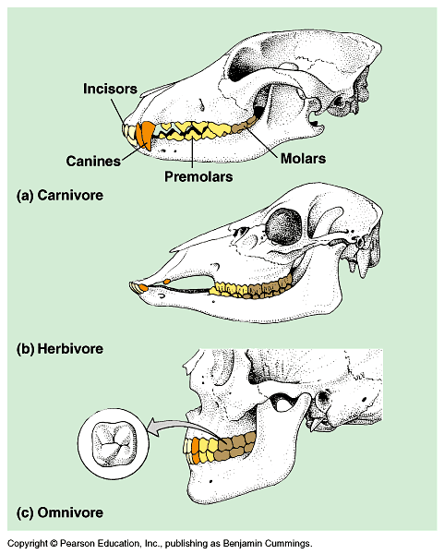
Teeth
Carnivore
  Sharp ripping teeth
  Large canines
Herbivore
  Wide grinding teeth
  Large molars
Omnivore
  Both kinds of teeth

Slide 37
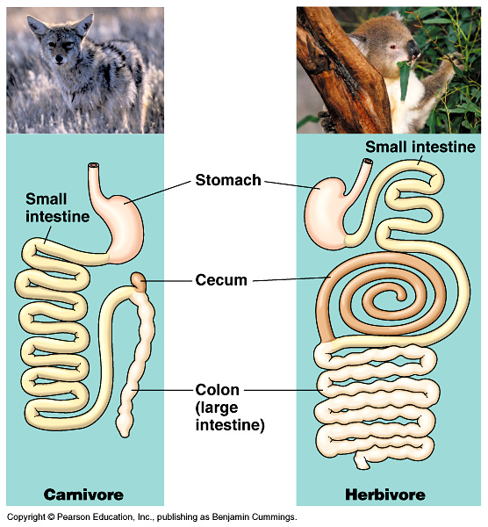
Length of Digestive System
Herbivores & omnivores
  Long digestive
  systems.
  Harder to digest cellulose (cell walls of plants).
  Bacteria needed in intestines help.
Carnivores
  Short digestive systems.
  Protein easier to
  digest than cellulose.

Slide 38
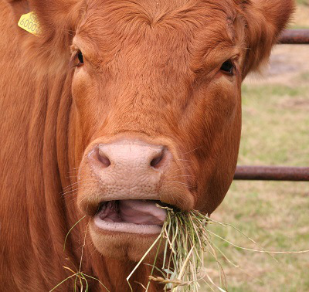
Different Stomachs - Ruminant
Ruminant stomachs are found in sheep, cows and goats. Are called cud-chewing mammals.
Cud chewing means they chew their food twice.
Their stomach occupies 3/4 of the abdominal cavity. Broken up into four parts -
  Rumen
  Reticulum
  Omasum
  Abomasum which is the “true” stomach
Video on cow digestion https://www.youtube.com/watch?v=svw5KA8YlAA

Slide 39
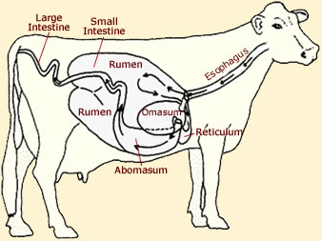
Different Stomachs - Ruminant
When a cow first takes a bite, it chews just enough to moisten the food.
Once swallowed, the food goes into the first section, the reticulum, where it mixes with other acidic digestive liquids and is softened. The softened food is called cud, small balls of food.
Next, the muscles send the cud back up to the cow’s mouth, where it is re-chewed and swallowed again. This time going to the rumen and omasum section of stomach in order to squeeze out all of the moisture.
Finally, the food enters the last part, Abomasum of the stomach where it mixes with digestive juices and makes its way to the intestine to be completely digested.
Notes:
Rumen Cud arrives here
Billions of anaerobic bacteria (symbiosis) convert cellulose into glucose
Fermentation of the glucose to produce organic acids

Slide 40
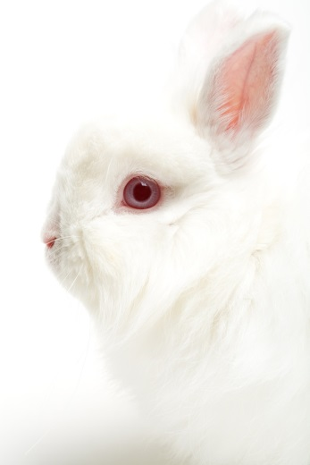
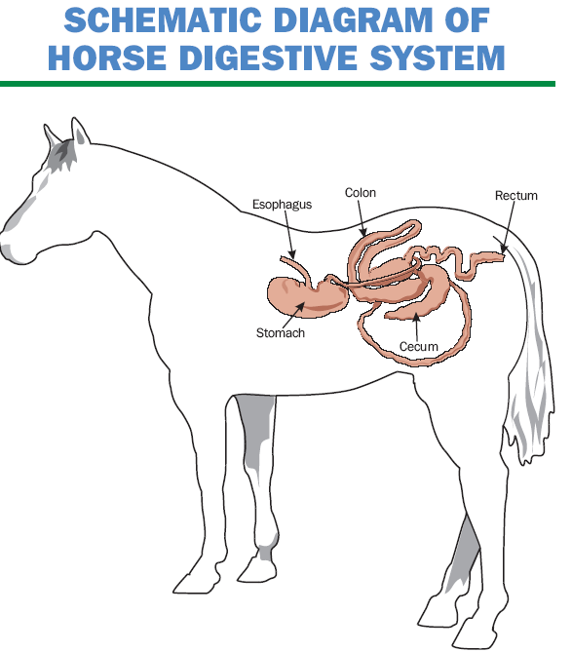
Different Intestines - Hind Gut fermenters
Different intestines are found in animals that eat large amounts of roughages (plant cellulose) but do not have ruminant stomachs.
Called hind-gut fermenters , they can utilize large amounts of roughages because of its greatly enlarged cecum (appendix) and large intestine.
Such an animal often re-ingest their own faeces to get all the nutrients from the food.
Examples are horses, rabbits, guinea pigs, and hamsters.
Notes:
Bacteria digest cellulose.

Slide 41
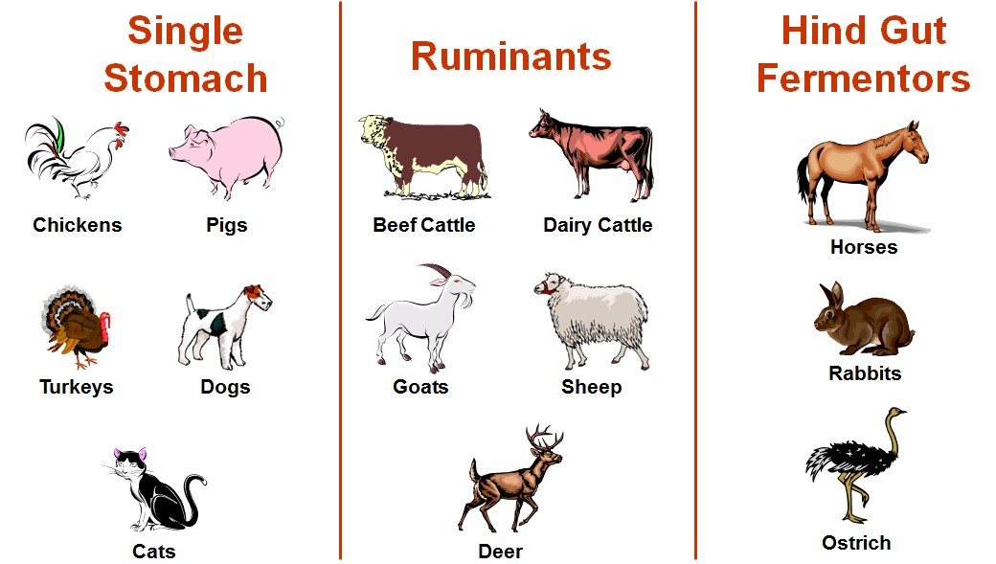
Examples

Slide 42
Comparison
Function | Single Stomach | Ruminants | Hind Gut Fermentors
Digest and extract energy from cellulose | Very limited (large intestine) | Yes (rumen/reticulum) | Yes (large intestine)
Utilize dietary sugar sources directly | Yes (absorbed as glucose) | No | Yes (absorbed as glucose)
Utilize protein from feeds directly | Yes | Limited | Yes
Utilize fat from feeds directly | Yes | Some | Yes

Slide 43
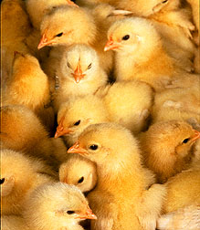
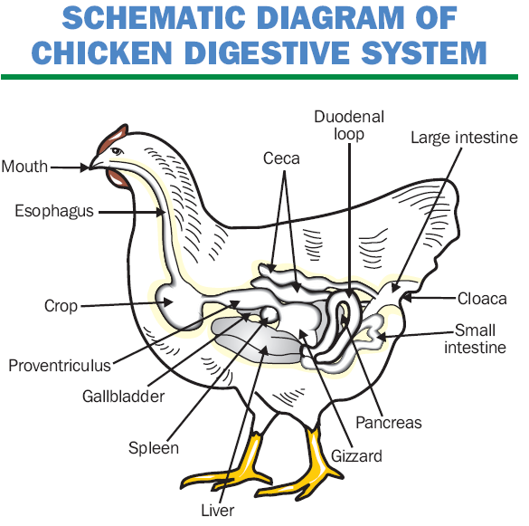
Birds – Unique System
This system differs greatly from any other type.
Since a bird has no teeth, no chewing is involved.
The esophagus empties directly into the crop. The crop is where the food is stored and soaked to make it wet.
Two parts to the stomach -
  Proventriculus: same as a single stomach and provides digestive excretions
  Gizzard: located after proventriculus, very muscular, used to grind food.
From the crop, the food makes its way to the gizzard. The gizzard is a very muscular organ, which normally contains stones or grit that grinds the food.
Digestion in the avian system is very rapid.
Video of a dissected chicken digestive system https://www.youtube.com/watch?v=2PLJ9pLxRnM

Slide 44

Surface Area - Key Feature of Digestive Systems
Because acquiring nutrients requires substances to move across the cell membrane (either into the whole unicellular organism or from the digestive system into the rest of the organism) a key feature is that there must be a large surface area.
All systems have features to increase the surface area of the sites where absorption occurs.

Slide 45
Success Criteria
Students will be able to:
Describe the structure and function of organs within the digestive system.
Differentiate between a gastrovascular cavity and specialised alimentary canal.
Explain mechanical and chemical digestion.
Identify specialisations within the digestive system related to diet (herbivores vs carnivores).

Slide 46




Exam Review Question

Slide 47

Moodle & Textbook Work
Read Nelson pages 362-369 & 497-407 and complete question sets as indicated on Moodle.
Don’t forget to do the questions in your revision guide also!

Slide 48
Student Feedback
What I learnt today…..
What I need to revise….

